Slide 1
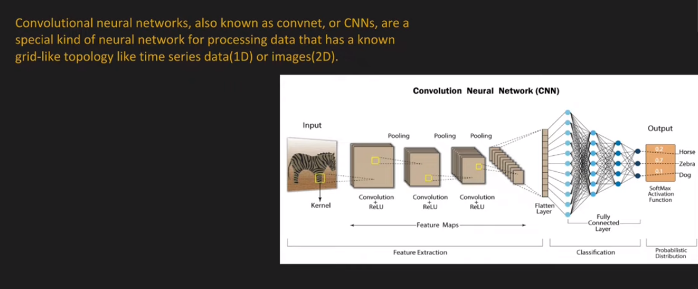
Convolutional Neural Network

Slide 2
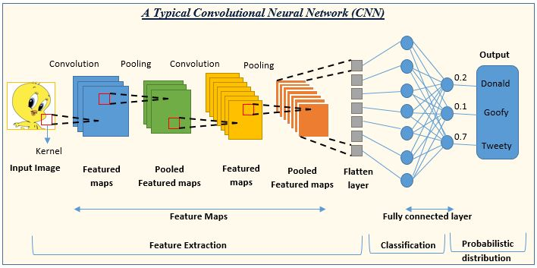

Slide 3
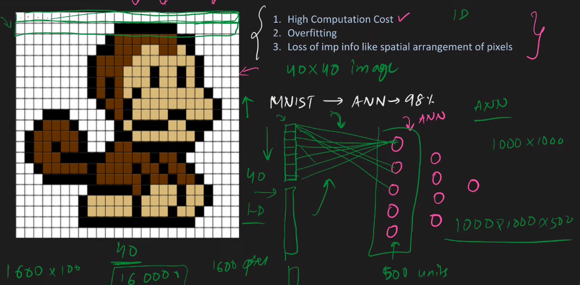
Why Not Use ANNs

Slide 4
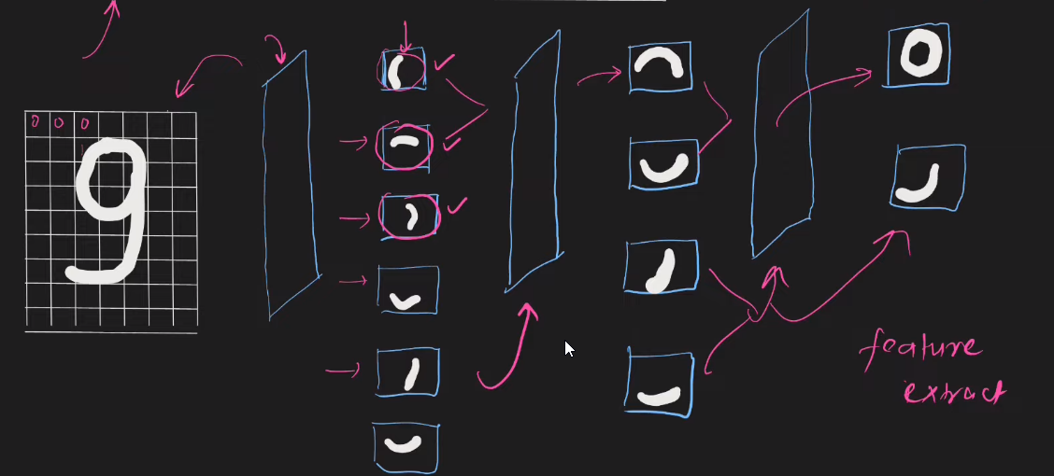
Intuition of CNN

Slide 5
Application of CNN

Slide 6
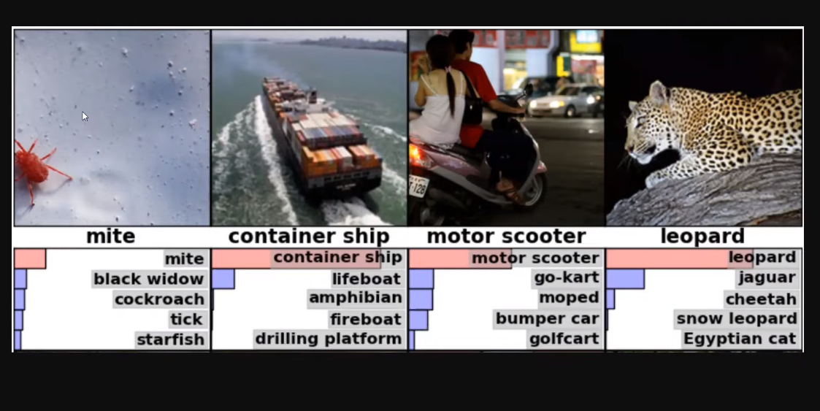
Image Classification

Slide 7
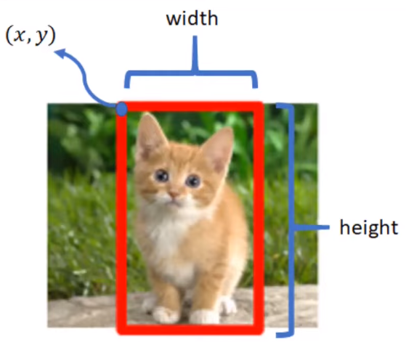
Image Localization

Slide 8
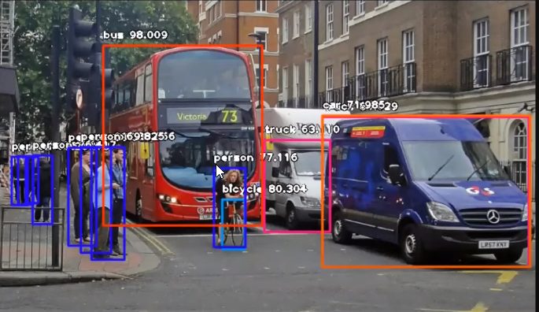
Object Detection

Slide 9
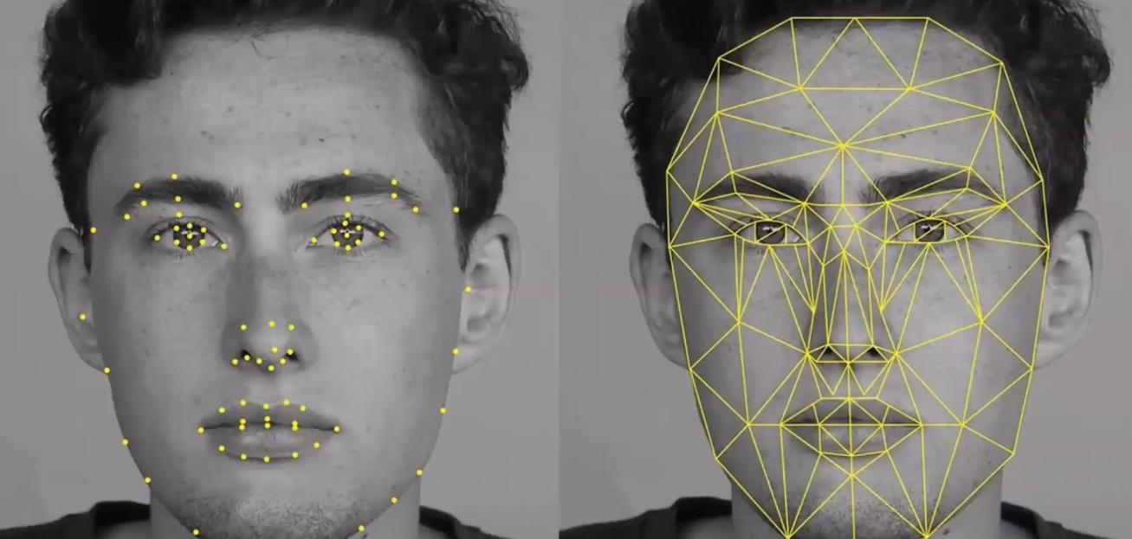
Facial Recognition

Slide 10
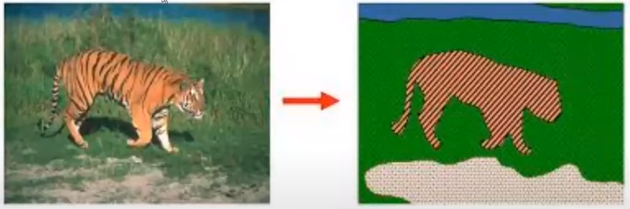
Image Segmentation

Slide 11
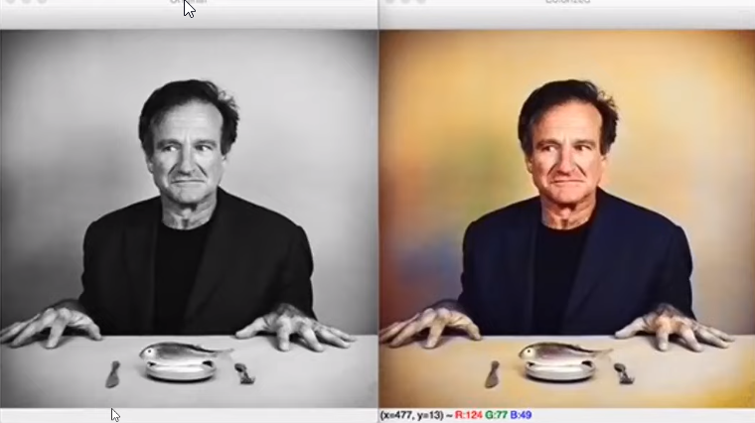

Slide 12
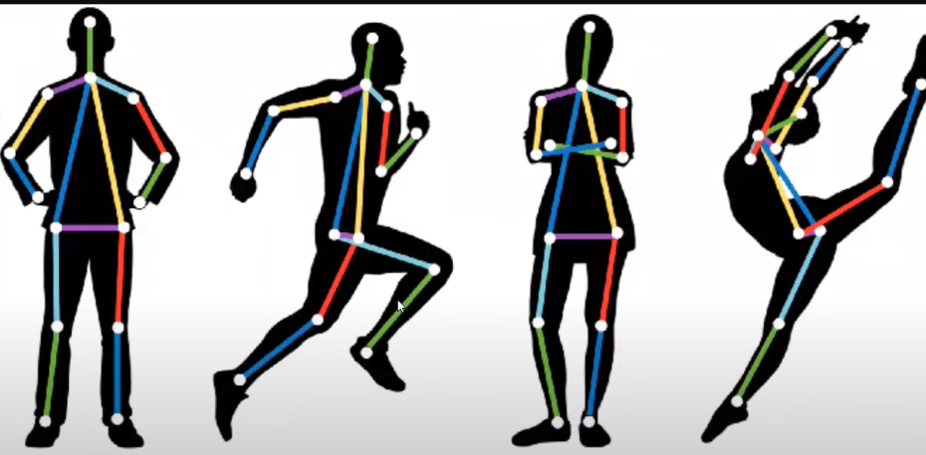
Pose Estimation

Slide 13
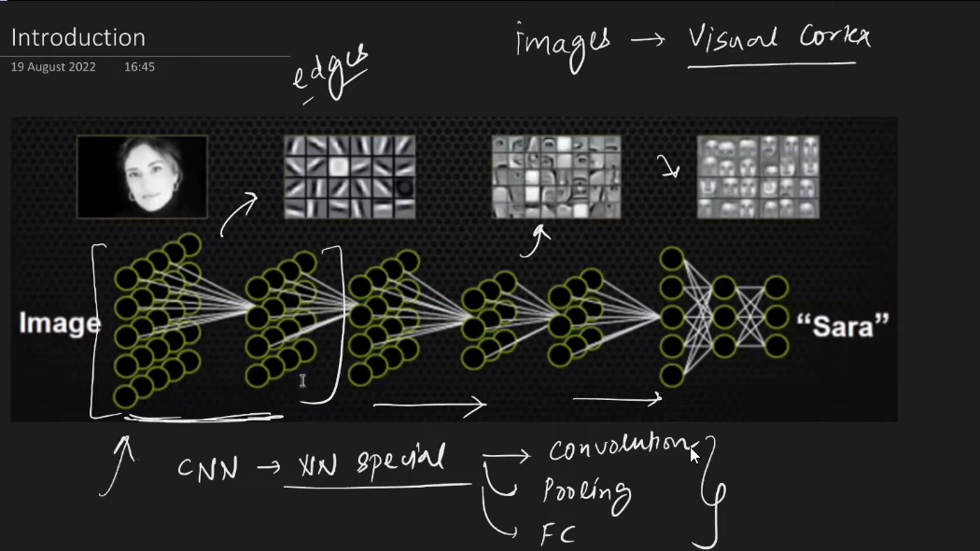

Slide 14
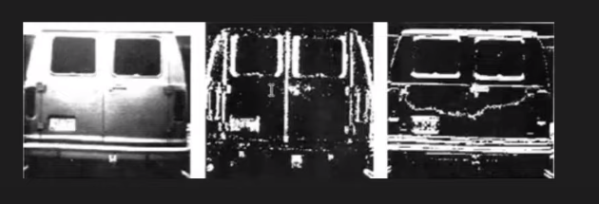
Convolution Operation (Edge Detection)
Vertical(Edge Detection)
Horizontal (Edge Detection)

Slide 15
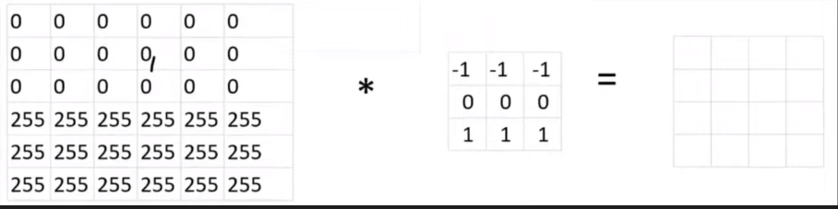
Convolution Operation (Edge Detection) Example

Slide 16
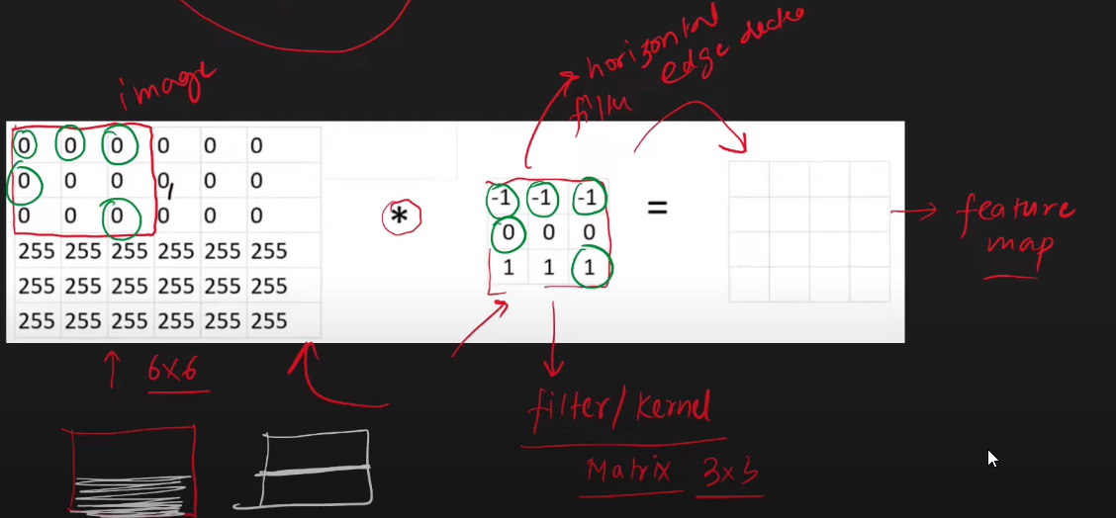

Slide 17
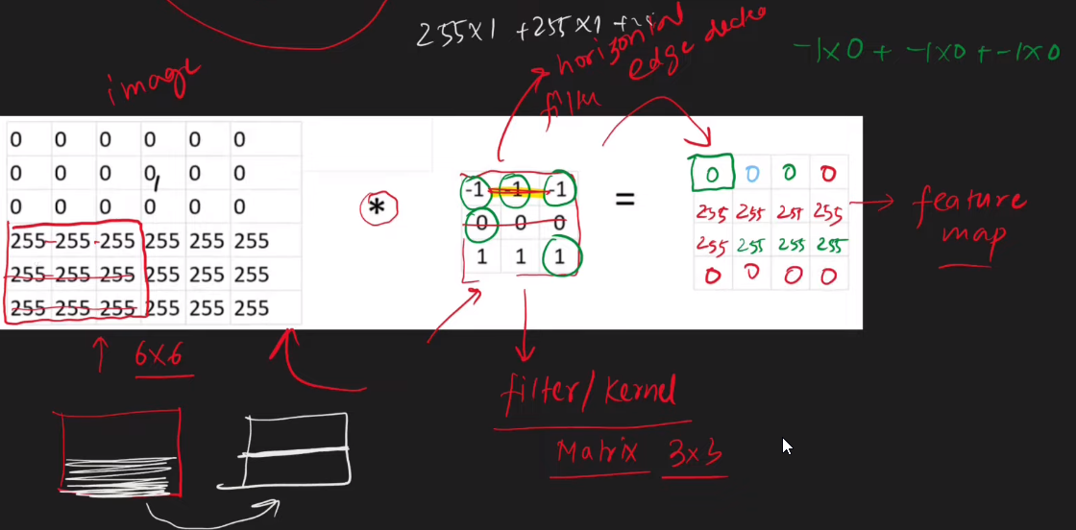

Slide 18
Convolution Operation (Edge Detection) Demo
https://deeplizard.com/resource/pavq7noze2

Slide 19
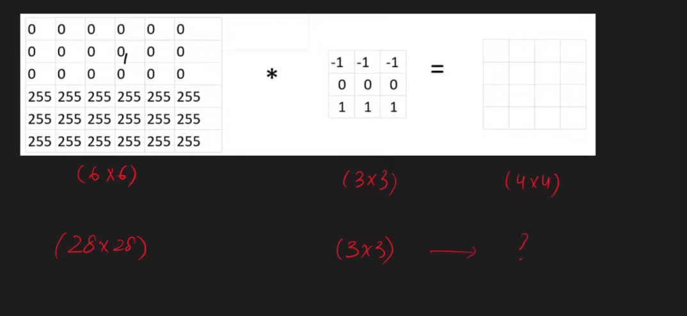

Slide 20
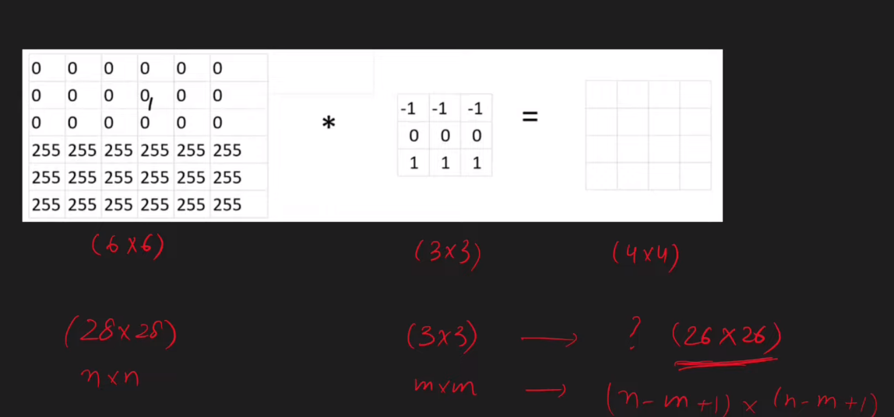

Slide 21
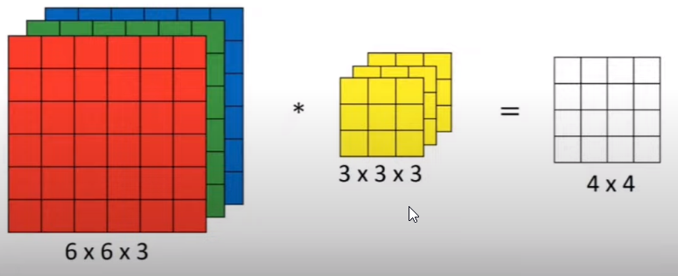
https://medium.com/swlh/convolutional-neural-networks-part-3-convolutions-over-volume-and-the-convnet-layer-91fb7c08e28b

Slide 22
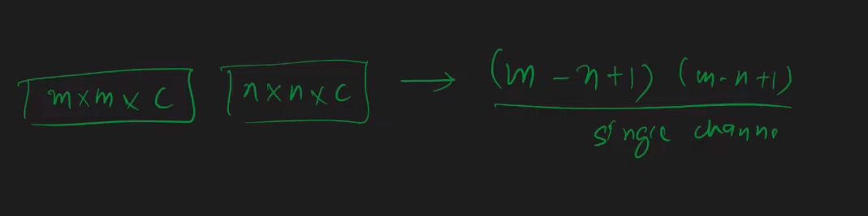

Slide 23
Padding & Stride
https://medium.com/latinxinai/convolutional-neural-network-from-scratch-6b1c856e1c07

Slide 24
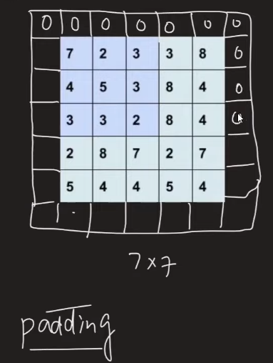
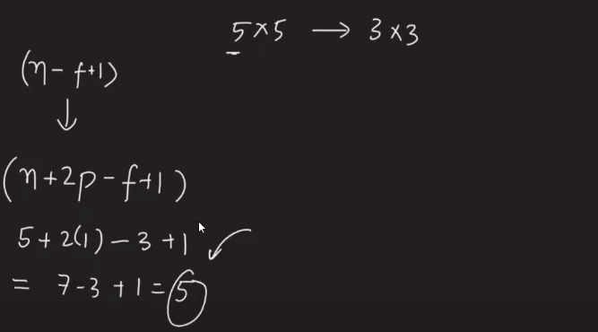

Slide 25
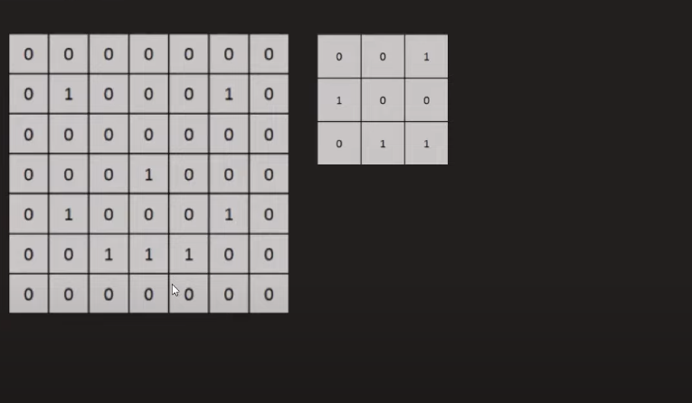

Slide 26
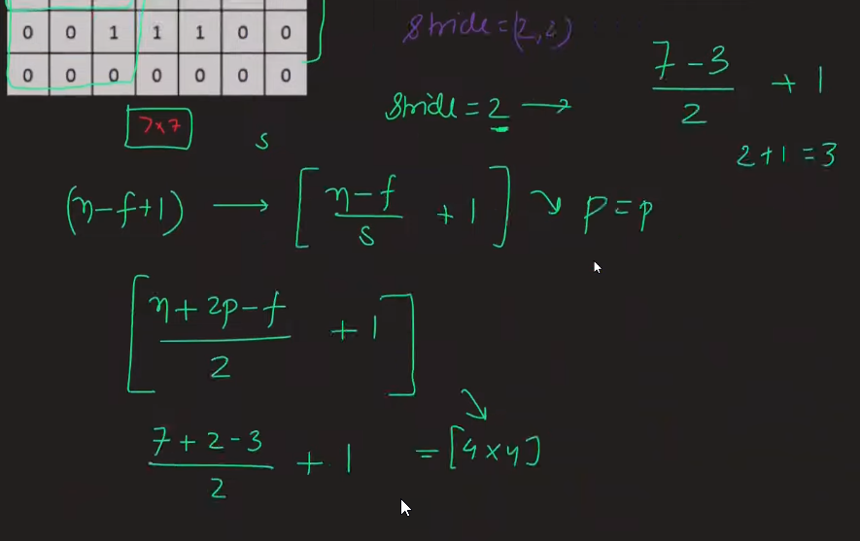

Slide 27
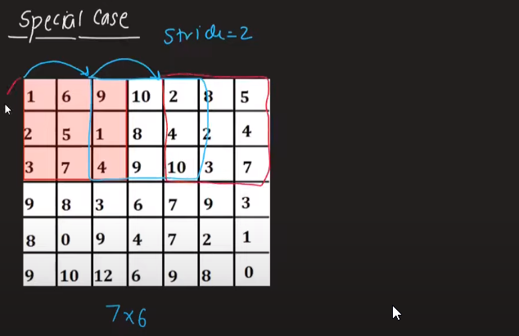

Slide 28
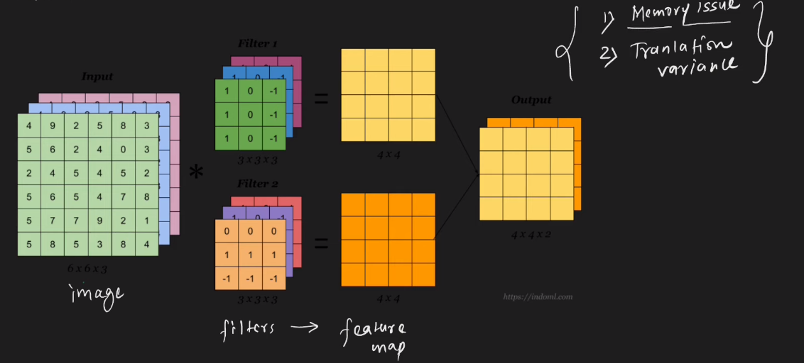
Max Pooling in CNN

Slide 29
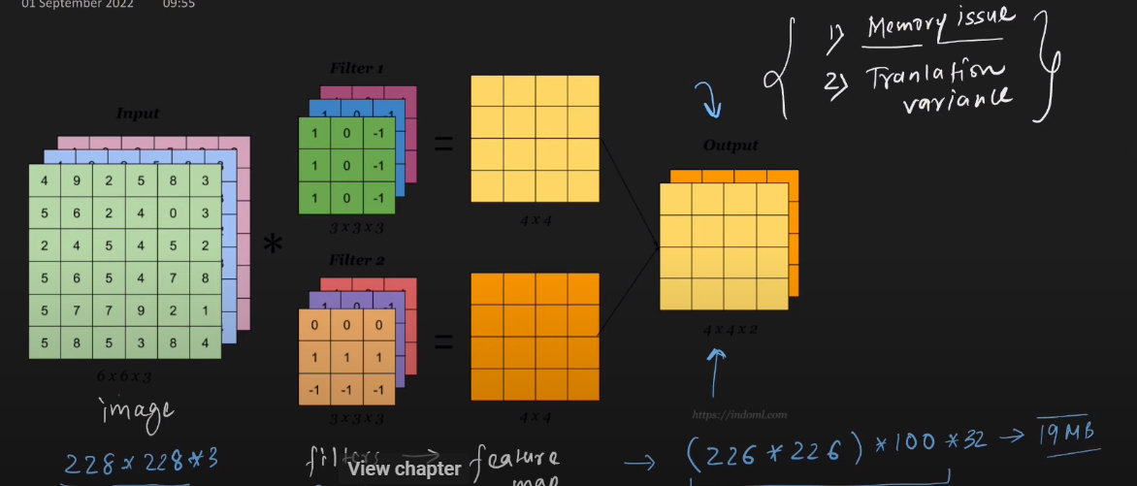

Slide 30
